Slide 1

Microsoft SQL Server
Presented By -
Phalguni Vatsa (10043)
Prakhar Jain (1004321)
Ram Somani (1004325)
Shashank Juneja (1004329)

Slide 2
Introduction
Microsoft SQL Server is a relational database management system developed by Microsoft. As a database server, it is a software product with the primary function of storing and retrieving data as requested by other software applications which may run either on the same computer or on another computer across a network.
Other important servers are :
SQL 2005 - YUKON
SQL 2008 - KATMAI
Version | Year | Code Name
2.0 | 1989 | MS SQL SERVER
1.1 | 1991 | -
4.21 | 1993 | SQLNT
6.0 | 1995 | SQL95
. | . | .
. | . | .
. | . | .
10.25 | 2010 | CloudDB Azure
11.0 | 2012 | DENALI
12.0 | 2014 | SQL 14
13.0 | TBD | -

Slide 3
SQL Server Editions
DataCenter
  Hardware/Software solution
Enterprise
Standard
Developer
Workgroup
Express
Windows Mobile
MAIN -- SPECCIAL EDITIONS .. WIKIPEDIA

Slide 4
Requirements
Memory
  Minimum:
    Express Editions: 512 MB
    All other editions: 1 GB
  Recommended:
    Express Editions: 1 GB
Processor Speed
  Minimum:
    x86 Processor: 1.0 GHz
    x64 Processor: 1.4 GHz
  Recommended:
    2.0 GHz or faster
Processor Type
  x64 Processor: AMD Opteron, AMD Athlon 64, Intel Xeon with Intel EM64T support,Intel Pentium IV with EM64T support
  x86 Processor: Pentium III-compatible processor or faster

Slide 5
Licensing
Per Processor
Per Server plus Device CALS
Per Server plus User CALS
SQL Server 2008 Express is free

Slide 6
Levels of Security
Login – Server Level
User – Database Level
Object – Permissions to Access Objects
Application Security
Network Access
Encryption

Slide 7
SQL Server Backup
Online Backup
  Users can access data during backup
Types:
  Full
  Differential
  Log
COPY_ONLY option
  Does not disturb normal backups, truncate logs, or reset any flags
Use of Filegroups

Slide 8
Web Technologies
Allow connection to SQL Server through HTTP
Used for logging, collecting data, reporting, data transfer and admin functions
Examples:
  ASP, ASP.Net, Perl, CGI, Cold Fusion, JSP, Java

Slide 9
Consists of several Components. A few are:
  Query Analyzer
  Profiler
  Service Manager
  Bulk Copy Program (BCP)

Slide 10
Profiler
Monitoring tool
Used for performance tuning
Uses traces – an event monitoring protocol
Event may be a query or a transaction like logins etc

Slide 11
Service Manager
Helps us to manage services
More than one instance of SQL server can be installed in a machine
First Instance is called as default instance
Rest of the instances (16 max) are called as named instances
Service manager helps in starting or stopping the instances individually

Slide 12
BCP
Bulk Copy Program
A powerful command line utility that enables us to transfer large number of records from a file to database
Time taken for copying to and from database is very less
Helps in back up and restoration

Slide 13
Query Analyzer
Allows us to write queries and SQL statements
Checks syntax of the SQL statement written
Executes the statements
Store and reload statements
Save the results in file
View reports (either as grid or as a text)

Slide 14
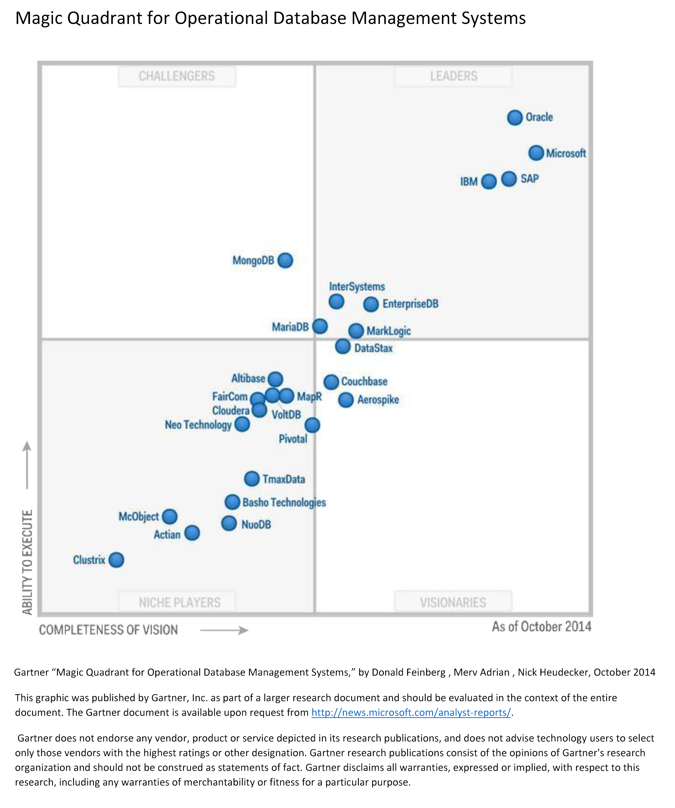

Slide 15
DATABASES | ORACLE | DB2 | MS SQL SEVER | MYSQL | MONGODB | CASSANDRA
VENDOR
OS
Interface

Slide 16
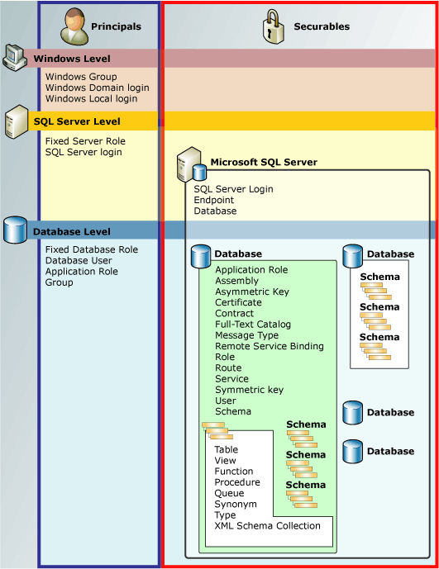

Slide 17
Benefits
Mission-critical performance
Platform for hybrid cloud
Faster insights on any data

Slide 18


Slide 19
Features
Easy integration with Microsoft Operating systems and products as .net.
User friendly interface
Easy to create maintenance plans.
Enhanced Security
Enhanced Optimizer
Easy Availability– one don’t have to pay huge bucks to make SQL Available.. he can use Express edition available free.

Slide 20
Why SQL SERVER
As always, “the best RDBMS” depends on what you want to do with it. Absolutely, SQL Server is the best ever if you are integrating with other MS products.
Easy integration with world’s most common database: Spreadsheet, Microsoft excel in particular and power pivot has significantly enhanced its value.
Mixed Authentication: Not only it gives the option to use windows authentication, it allows other applications to authenticate based on username and password
Data Encryption: SQL Server 2008 provides a lot of encryption options to encrypt data and code. Transparent Data Encryption has really safe guarded some of the crucial data movement operations our company.

